Slide 1
Foundations of Modern Networking
SDN, NFV, QoE, IoT, and Cloud
By: William Stallings

Slide 2
Chapter 5
SDN Control Plane
Notes:
After studying this chapter, you should be able to
■ List and explain the key functions of the SDN control plane.
■ Discuss the routing function in the SDN controller.
■ Understand the ITU-T Y.3300 layered SDN model.
■ Present an overview of OpenDaylight.
■ Present an overview of REST.
■ Compare centralized and distributed SDN controller architectures.
■ Explain the role of BGP in an SDN network.

Slide 3
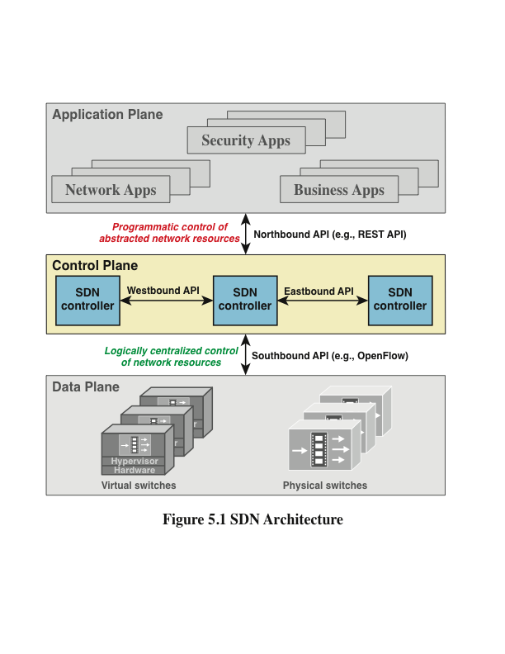
Notes:
This chapter continues our study of software-defined networking (SDN), focusing on the control
plane (see Figure 5.1). Section 5.1 provides an overview of SDN control plane architecture, discussing
the functions and interface capabilities of a typical SDN control plane implementation. Next, we
summarize the ITU-T layered SDN model, which provides additional insight into the role of the control
plane. This is followed by a description of one of the most significant open source SDN controller
efforts, known as OpenDaylight. Then Section 5.4 describes the REST northbound interface, which
has become common in SDN implementations. Finally, Section 5.5 discusses issues relating to cooperation
and coordination among multiple SDN controllers.
The SDN control layer maps application layer service requests into specific commands
and directives to data plane switches and supplies applications with information about
data plane topology and activity. The control layer is implemented as a server or cooperating
set of servers known as SDN controllers. This section provides an overview of
control plane functionality. Later, we look at specific protocols and standards implemented
within the control plane.

Slide 4
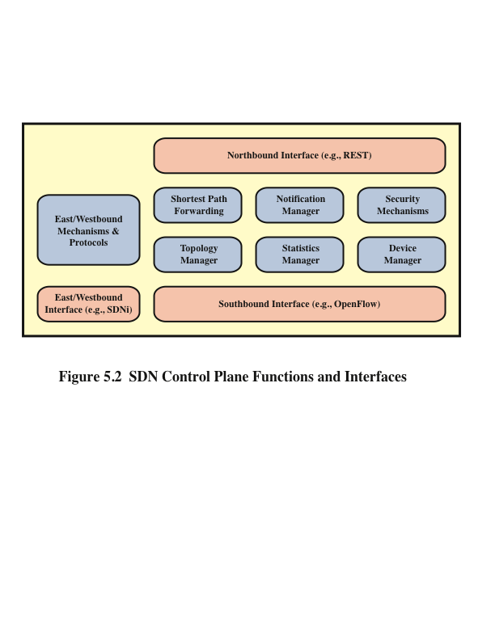
Notes:
Figure 5.2 illustrates the functions performed by SDN controllers. The figure illustrates
the essential functions that any controller should provide, as suggested in a
paper by Kreutz [KREU15], which include the following:
■ Shortest path forwarding: Uses routing information collected from
switches to establish preferred routes.
■ Notification manager: Receives, processes, and forwards to an application
events, such as alarm notifications, security alarms, and state changes.
■ Security mechanisms: Provides isolation and security enforcement
between applications and services.
■ Topology manager: Builds and maintains switch interconnection topology
information.
■ Statistics manager: Collects data on traffic through the switches.
■ Device manager: Configures switch parameters and attributes and manages
flow tables.

Slide 5
Network Operating System (NOS)
The functionality provided by the SDN controller can be viewed as a network operating system
A NOS provides essential services, common application programming interfaces (APIs), and an abstraction of lower-layer elements to developers
The functions of an SDN NOS enable developers to define network policies and manage networks without concern for the details of the network device characteristics
Notes:
The functionality provided by the SDN controller can be viewed as a network
operating system (NOS) . As with a conventional OS, an NOS provides essential
services, common application programming interfaces (APIs), and an abstraction of
lower-layer elements to developers. The functions of an SDN NOS, such as those in
the preceding list, enable developers to define network policies and manage networks
without concern for the details of the network device characteristics, which may
be heterogeneous and dynamic. The northbound interface, discussed subsequently,
provides a uniform means for application developers and network managers to access
SDN service and perform network management tasks. Further, well-defined northbound
interfaces enable developers to create software that is independent not only of
data plane details but to a great extent usable with a variety of SDN controller servers.

Slide 6
A number of different initiatives, both commercial and open source, have resulted in SDN controller implementations:
OpenDaylight
Open Network Operating System (ONOS)
POX
Beacon
Floodlight
Ryu
Onix
Notes:
A number of different initiatives, both commercial and open source, have resulted in
SDN controller implementations. The following list describes a few prominent ones:
■ OpenDaylight: An open source platform for network programmability to enable
SDN, written in Java. OpenDaylight was founded by Cisco and IBM, and
its membership is heavily weighted toward network vendors. OpenDaylight
can be implemented as a single centralized controller, but enables controllers
to be distributed where one or multiple instances may run on one or more clustered
servers in the network.
■ Open Network Operating System (ONOS): An open source SDN NOS,
initially released in 2014. It is a nonprofit effort funded and developed by
a number of carriers, such as AT&T and NTT, and other service providers.
Significantly, ONOS is supported by the Open Networking Foundation,
making it likely that ONOS will be a major factor in SDN deployment. ONOS
is designed to be used as a distributed controller and provides abstractions for
partitioning and distributing network state onto multiple distributed controllers.
■ POX: An open source OpenFlow controller that has been implemented by a
number of SDN developers and engineers. POX has a well written API and
documentation. It also provides a web-based graphical user interface (GUI)
and is written in Python, which typically shortens its experimental and developmental
cycles compared to some other implementation languages, such as
C++.
■ Beacon: An open source package developed at Stanford. Written in Java and
highly integrated into the Eclipse integrated development environment (IDE).
Beacon was the first controller that made it possible for beginner programmers
to work with and create a working SDN environment.
■ Floodlight: An open source package developed by Big Switch Networks.
Although its beginning was based on Beacon, it was built using Apache Ant,
which is a very popular software build tool that makes the development of
Floodlight easier and more flexible. Floodlight has an active community and
has a large number of features that can be added to create a system that best
meets the requirements of a specific organization. Both a web-based and Javabased
GUI are available and most of its functionality is exposed through a
REST API.
■ Ryu: An open source component-based SDN framework developed by NTT
Labs. It is open sourced and fully developed in python.
■ Onix: Another distributed controller, jointly developed by VMWare, Google,
and NTT. Onix is a commercially available SDN controller.

Slide 7
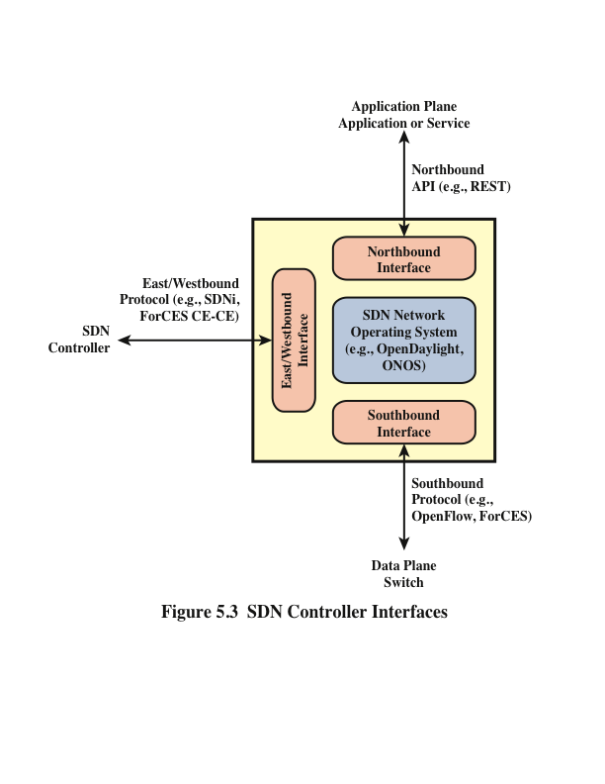
Notes:
The southbound interface provides the logical connection between the SDN controller
and the data plane switches (see Figure 5.3). Some controller products and configurations
support only a single southbound protocol. A more flexible approach is the use of
a southbound abstraction layer that provides a common interface for the control plane
functions while supporting multiple southbound APIs.
The most commonly implemented southbound API is OpenFlow, covered in some
detail in Chapter 4, “SDN Data Plane and OpenFlow.” Other southbound interfaces
include the following:
■ Open vSwitch Database Management Protocol (OVSDB): Open
vSwitch (OVS) an open source software project which implements virtual
switching that is interoperable with almost all popular hypervisors. OVS uses
OpenFlow for message forwarding in the control plane for both virtual and
physical ports. OVSDB is the protocol used to manage and configure OVS
instances.
■ Forwarding and Control Element Separation (ForCES): An IETF
effort that standardizes the interface between the control plane and the data
plane for IP routers.
■ Protocol Oblivious Forwarding (POF): This is advertised as an enhancement
to OpenFlow that simplifies the logic in the data plane to a very generic
forwarding element that need not understand the protocol data unit (PDU)
format in terms of fields at various protocol levels. Rather, matching is done
by means of (offset, length) blocks within a packet. Intelligence about packet
format resides at the control plane level.

Slide 8
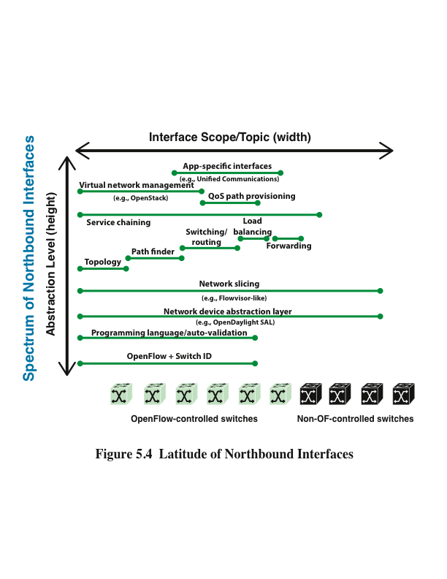
Notes:
The northbound interface enables applications to access control plane functions and
services without needing to know the details of the underlying network switches. The
northbound interface is more typically viewed as a software API rather than a protocol.
Unlike the southbound and eastbound/westbound interfaces, where a number of
heterogeneous interfaces have been defined, there is no widely accepted standard for
the northbound interface. The result has been that a number of unique APIs have
been developed for various controllers, complicating the effort to develop SDN applications.
To address this issue the Open Networking Foundation formed the Northbound
Interface Working Group (NBI-WG) in 2013, with the objective of defining
and standardizing a number of broadly useful northbound APIs. As of this writing, the
working group has not issued any standards.
A useful insight of the NBI-WG is that even in an individual SDN controller instance,
APIs are needed at different “latitudes.” That is, some APIs may be “further north”
than others, and access to one, several, or all of these different APIs could be a
requirement for a given application.
Figure 5.4, from the NBI-WG charter document (October 2013), illustrates the concept
of multiple API latitudes. For example, an application may need one or more APIs
that directly expose the functionality of the controller, to manage a network domain,
and use APIs that invoke analytic or reporting services residing on the controller.

Slide 9
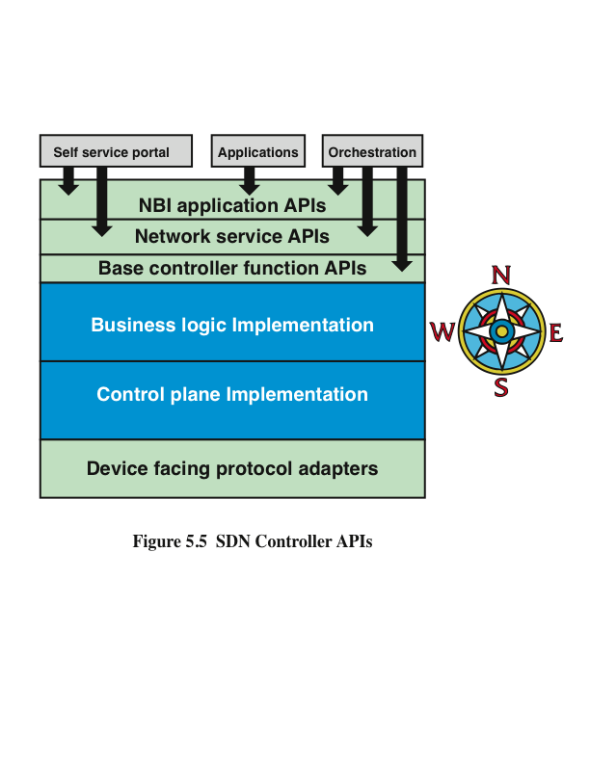
Notes:
Figure 5.5 shows a simplified example of an architecture with multiple levels of northbound
APIs, the levels of which are described in the list that follows.
■ Base controller function APIs: These APIs expose the basic functions of
the controller and are used by developers to create network services.
■ Network service APIs: These APIs expose network services to the north.
■ Northbound interface application APIs: These APIs expose application-related
services that are built on top of network services.

Slide 10
Routing
The routing function comprises a protocol for collecting information about the topology and traffic conditions of the network, and an algorithm for designing routes through the network
There are two categories of routing protocols:
Interior router protocols (IRPs) that operate within an autonomous system (AS)
Concerned with discovering the topology of routers within an AS and then determining the best route to each destination based on different metrics
Exterior router protocols (ERPs) that operate between autonomous systems
Need not collect as much detailed traffic information
Primary concern is to determine reachability of networks and end systems outside of the AS
Notes:
As with any network or internet, an SDN network requires a routing function. In
general terms, the routing function comprises a protocol for collecting information
about the topology and traffic conditions of the network, and an algorithm for designing
routes through the network. Recall from Chapter 2, “Requirements and Technology,”
that there are two categories of routing protocols: interior router protocols (IRPs) that
operate within an autonomous system (AS), and exterior router protocols (ERPs) that
operate between autonomous systems.
IRP is concerned with discovering the topology of routers within an AS and
then determining the best route to each destination based on different metrics. Two
widely used IRPs are Open Shortest Path First (OSPF) Protocol and Enhanced Interior
Gateway Routing Protocol (EIGRP). An ERP need not collect as much detailed traffic
information. Rather, the primary concern with an ERP is to determine reachability of
networks and end systems outside of the AS. Therefore, the ERP is typically executed
only in edge nodes that connect one AS to another. Border Gateway Protocol (BGP)
is commonly used for the ERP.

Slide 11
Routing
Traditionally the routing function is distributed among the routers in a network
In an SDN controlled network, it makes sense to centralize the routing function within the SDN controller
The controller can develop a consistent view of the network state for calculating shortest paths and can implement application aware routing policies
The data plane switches are relieved of the processing and storage burden associated with routing, leading to improved performance
Notes:
Traditionally, the routing function is distributed among the routers in a network. Each
router is responsible for building up an image of the topology of the network. For
interior routing, each router as well must collect information about connectivity and
delays and then calculate the preferred route for each IP destination address. However,
in an SDN-controlled network, it makes sense to centralize the routing function within
the SDN controller. The controller can develop a consistent view of the network state
for calculating shortest paths, and can implement application-aware routing policies.
The data plane switches are relieved of the processing and storage burden associated
with routing, leading to improved performance.

Slide 12
Routing
The centralized routing application performs two distinct functions:
Link discovery
The routing function needs to be aware of links between data plane switches
Must be performed between a router and a host system and between a router in the domain of this controller and a router in a neighboring domain
Discovery is triggered by unknown traffic entering the controller’s network domain either from an attached host or from a neighboring router
Topology manager
Maintains the topology information for the network and calculates routes in the network
Route calculation involves determining the shortest path between two data plane nodes or between a data plane node and a host
Notes:
The centralized routing application performs two distinct functions: link discovery and
topology manager.
For link discovery , the routing function needs to be aware of links between data
plane switches. Note that in the case of an internetwork, the links between routers are
networks, whereas for Layer 2 switches, such as Ethernet switches, the links are direct
physical links. In addition, link discovery must be performed between a router and
a host system and between a router in the domain of this controller and a router in a
neighboring domain. Discovery is triggered by unknown traffic entering the controller’s
network domain either from an attached host or from a neighboring router.
The topology manager maintains the topology information for the network and
calculates routes in the network. Route calculation involves determining the shortest
path between two data plane nodes or between a data plane node and a host.

Slide 13
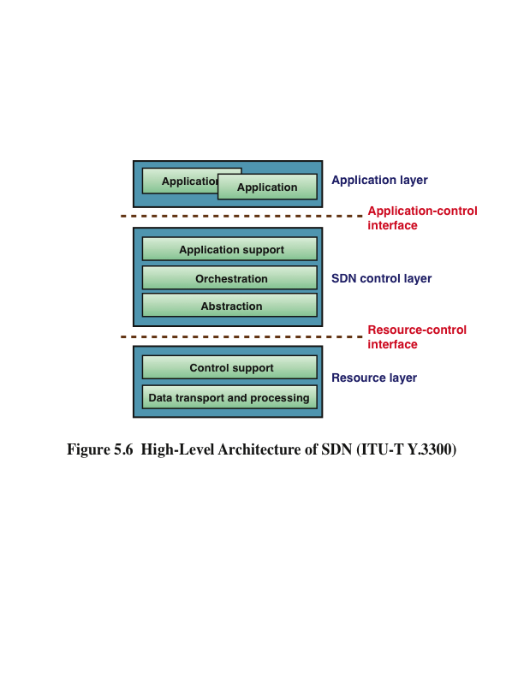
Notes:
Before proceeding to a discussion of an SDN controller design, it will be useful to
look at the SDN high-level architecture defined in ITU-T Y.3300 (see Figure 5.6).
As was depicted in Figure 3.3, the Y.3300 model consists of three layers, or planes:
application, control, and resource. As defined in Y.3300, the application layer is
where SDN applications specify network services or business applications by defining
a service-aware behavior of network resources. The applications interact with the SDN
control layer via APIs that form an application-control interface. The applications
make use of an abstracted view of the network resources provided by the SDN control
layer by means of information and data models exposed via the APIs.
The control layer provides a means to dynamically control the behavior of network
resources, as instructed by the application layer. The control layer can be viewed as
having the following sublayers:
■ Application support: Provides an API for SDN applications to access network
information and program application-specific network behavior.
■ Orchestration: Provides the automated control and management of network
resources and coordination of requests from the application layer for network
resources. Orchestration encompasses physical and virtual network topologies,
network elements, traffic control, and other network-related aspects.
■ Abstraction: Interacts with network resources, and provides an abstraction
of the network resources, including network capabilities and characteristics,
to support management and orchestration of physical and virtual network resources.
Such abstraction relies upon standard information and data models
and is independent of the underlying transport infrastructure.
The resource layer consists of an interconnected set of data plane forwarding
elements (switches). Collectively, these switches perform the transport and processing
of data packets according to decisions made by the SDN control layer and forwarded
to the resource layer via the resource-control interface. Most of this control is on
behalf of applications. However, the SDN control layer, on its own behalf, may
execute control of the resource layer for the sake of performance (for example, traffic
engineering). The resource layer can be viewed as having the following sublayers:
■ Control support: Supports programmability of resource-layer functions via
the resource-control interface.
■ Data transport and processing: Provides data forwarding and data routing
functions.
The SDN design philosophy seeks to minimize the complexity and processing
burden on the data switches. Accordingly, we can expect that many, if not most, of
the commercial SDN switches will be equipped with a single southbound interface,
such as OpenFlow, for simplicity of implementation and configuration. But different
switches may support different southbound interfaces to the controller. Therefore, the
SDN controller should support multiple protocols and interfaces to the data plane and
be able to abstract all of these interfaces to a uniform network model to be used the
application layer.

Slide 14
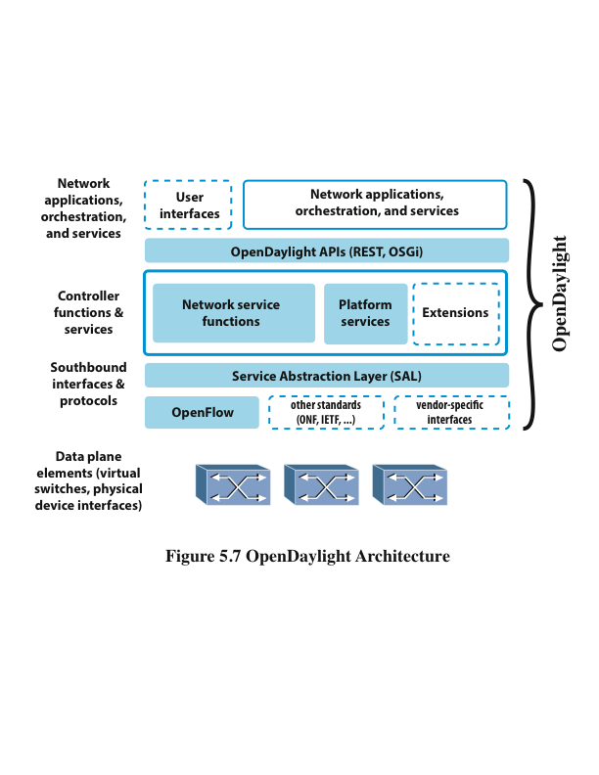
Notes:
Figure 5.7 provides a top-level view of the OpenDaylight architecture. It consists of
five logical layers, as further described in the list that follows.
■ Network applications, orchestration, and services: Consists of business
and network logic applications that control and monitor network behavior.
These applications use the controller to gather network intelligence, run algorithms
to perform analytics, and then use the controller to orchestrate the new
rules, if any, throughout the network.
APIs: A set of common interfaces to OpenDaylight controller functions.
OpenDaylight supports the Open Service Gateway Initiative (OSGi)
framework and bidirectional REST for the northbound API. The OSGi
framework is used for applications that will run in the same address space
as the controller, while the REST (web-based) API is used for applications
that do not run in the same address space (or even necessarily on the same
machine) as the controller.
■ Controller functions and services: SDN control plane functions and
services.
■ Service abstraction layer (SAL): Provides a uniform view of data plane
resources, so that control plane functions can be implemented independent of
the specific southbound interface and protocol.
■ Southbound interfaces and protocols: Supports OpenFlow, other standard
southbound protocols, and vendor-specific interfaces.
There are several noteworthy aspects to the OpenDaylight architecture. First, Open-
Daylight encompasses both control plane and application plane functionality. Thus,
OpenDaylight is more than just an SDN controller implementation. This enables
enterprise and telecommunications network managers to host open source software on
their own servers to construct an SDN configuration. Vendors can use this software to
create products with value-added additional application plane functions and services.

Slide 15
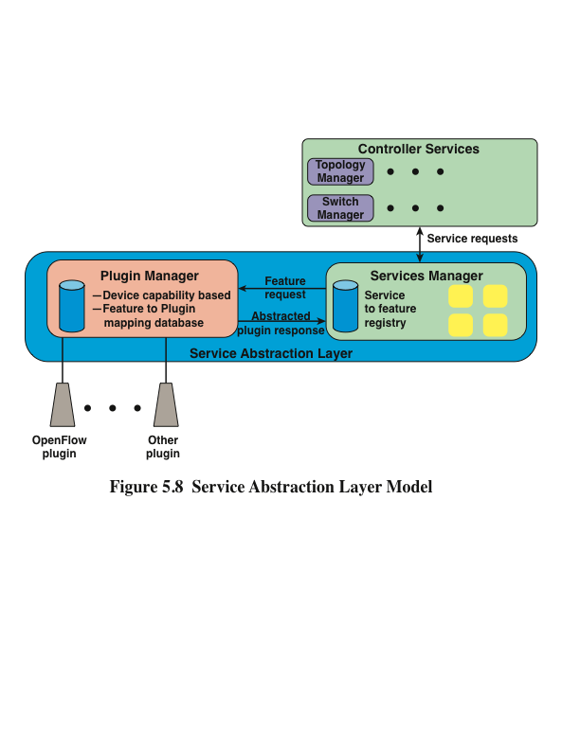
Notes:
A second significant aspect of the OpenDaylight design is that it is not tied to
OpenFlow or any other specific southbound interface. This provides greater flexibility
in constructing SDN network configurations. The key element in this design is the
SAL, which enables the controller to support multiple protocols on the southbound
interface and provide consistent services for controller functions and for SDN applications.
Figure 5.8 illustrates the operation of the SAL. The OSGi framework provides
for dynamically linking plug-ins for the available southbound protocols. The capabilities
of these protocols are abstracted to a collection of features that can be invoked by
control plane services via a services manager in the SAL. The services manager maintains
a registry that maps service requests to feature requests. Based on the service
request, the SAL maps to the appropriate plug-in and thus uses t he most appropriate
southbound protocol to interact with a given network device.
The emphasis in the OpenDaylight project is that the software suite be modular, pluggable,
and flexible. All of the code is implemented in Java and is contained within its
own Java Virtual Machine (JVM). As such, it can be deployed on any hardware and
operating system platform that supports Java.

Slide 16
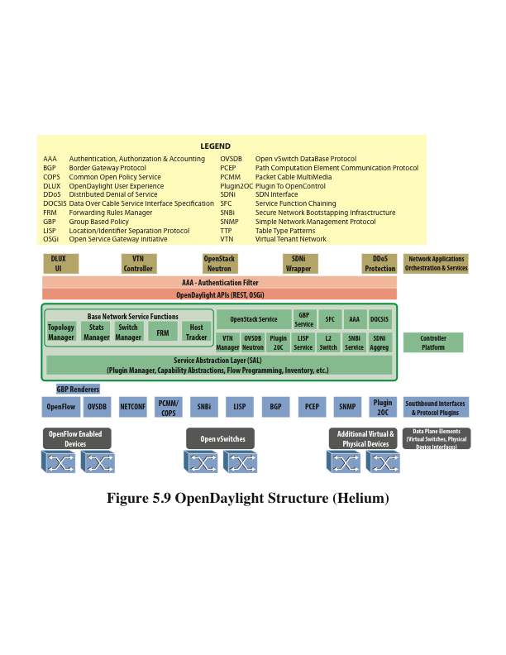
Notes:
At the time of this writing, the most recent release of OpenDaylight is the Helium
release, illustrated in Figure 5.9. The controller platform (exclusive of applications,
which may also run on the controller) consists of a growing collection of dynamically
pluggable modules, each of which performs one or more SDN-related functions and
services. Five modules are considered base network service functions, likely to be
included in any OpenDaylight implementation, as described in the list that follows.
■ Topology manager: A service for learning the network layout by subscribing
to events of node addition and removal and their interconnection. Applications
requiring network view can use this service.
■ Statistics manager: Collects switch-related statistics, including flow
statistics, node connector, and queue occupancy.
■ Switch manager: Holds the details of the data plane devices. As a switch
is discovered, its attributes (for example, what switch/router it is, software
version, capabilities) are stored in a database by the switch manager.
■ Forwarding rules manager: Installs routes and tracks next-hop information.
Works in conjunction with switch manager and topology manager to
register and maintain network flow state. Applications using this need not have
visibility of network device specifics.
■ Host tracker: Tracks and maintains information about connected hosts.

Slide 17
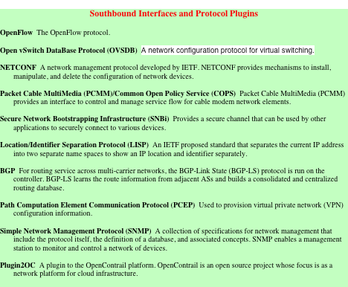
Table 5.1
OpenDaylight Modules
Notes:
To augment these base services, a number of other modules have been developed to
enable implementation of more sophisticated and feature-rich controllers, as described
in Table 5.1.

Slide 18
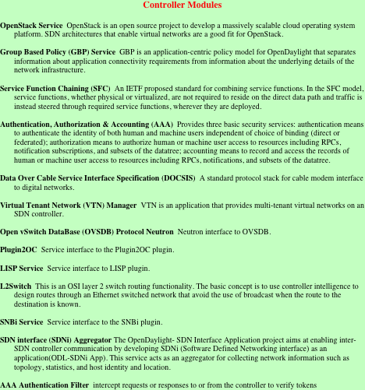
Table 5.1 OpenDaylight Modules

Slide 19
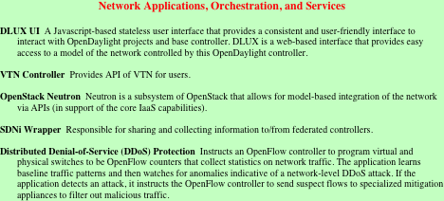
Table 5.1 OpenDaylight Modules

Slide 20
REpresentational State Transfer (REST)
An architectural style used to define APIs
This has become a standard way of constructing northbound APIs for SDN controllers
A REST API, or an API that is RESTful is not a protocol, language, or established standard
It is essentially six constraints that an API must follow to be RESTful
The objective of these constraints is to maximize the scalability and independence/interoperability of software interactions, and to provide for a simple means of constructing APIs
Notes:
REpresentational State Transfer (REST) is an architectural style used to define
APIs. This has become a standard way of constructing northbound APIs for SDN
controllers. A REST API, or an API that is RESTful (adheres to the constraints
of REST) is not a protocol, language, or established standard. It is essentially six
constraints that an API must follow to be RESTful. The objective of these constraints
is to maximize the scalability and independence/interoperability of software
interactions, and to provide for a simple means of constructing APIs.

Slide 21
REST Constraints
The six REST constraints are:
1
2
3
4
5
6
Client-server
Stateless
Cache
Uniform interface
Layered system
Code on demand
Notes:
REST assumes that the concepts of web-based access are used for interaction between
the application and the service that are on either side of the API. REST does not
define the specifics of the API but imposes constraints on the nature of the interaction
between application and service. The six REST constraints are as follows:
■ Client-server
■ Stateless
■ Cache
■ Uniform interface
■ Layered system
■ Code on demand

Slide 22
Client Server
This simple constraint dictates that interaction between application and server is in the client-server request/response style
The principle defined for this constraint is the separation of user interface concerns from data storage concerns
This separation allows client and server components to evolve independently and supports the portability of server-side functions to multiple platforms
Notes:
This simple constraint dictates that interaction between application and server is in
the client-server request/response style. The principle defined for this constraint is
the separation of user interface concerns from data storage concerns. This separation
allows client and server components to evolve independently and supports the
portability of server-side functions to multiple platforms.

Slide 23
2
Stateless Constraint
Dictates that each request from a client to a server must contain all the information necessary to understand the request and cannot take advantage of any stored context on the server
Similarly, each response from the server must contain all the desired information for that request
One consequence is that any memory of a transaction is maintained in a session state kept entirely on the client
Another consequence is that if the client and server reside on different machines, and therefore communicate via a protocol, that protocol need not be connection oriented
REST typically runs over Hypertext Transfer Protocol (HTTP), which is a stateless protocol
Notes:
The stateless constraint dictates that each request from a client to a server must contain
all the information necessary to understand the request and cannot take advantage
of any stored context on the server. Similarly, each response from the server must
contain all the desired information for that request. One consequence is that any
“memory” of a transaction is maintained in a session state kept entirely on the client.
Because the server does not retain any record of the client state, the result is a more
efficient SDN controller. Another consequence is that if the client and server reside on
different machines, and therefore communicate via a protocol, that protocol need not
be connection oriented.
REST typically runs over Hypertext Transfer Protocol (HTTP), which is a stateless
protocol.

Slide 24
3
Cache Constraint
Requires that the data within a response to a request be implicitly or explicitly labeled as cacheable or non-cacheable
If a response is cacheable, then a client cache is given the right to reuse that response data for later, equivalent requests
Therefore, subsequent requests for the same data can be handled locally at the client, reducing communication overhead between client and server
Notes:
The cache constraint requires that the data within a response to a request be implicitly
or explicitly labeled as cacheable or noncacheable. If a response is cacheable, then a
client cache is given the right to reuse that response data for later, equivalent requests.
That is, the client is given permission to remember this data because the data is not
likely to change on the server side. Therefore, subsequent requests for the same data
can be handled locally at the client, reducing communication overhead between client
and server, and reducing the server’s processing burden.

Slide 25
4
Uniform Interface Constraint
REST emphasizes a uniform interface between components, regardless of the specific client-server application API implemented using REST
To obtain a uniform interface, REST defines four interface constraints:
Identification of resources
Manipulation of resources through representations
Self-descriptive messages
Hypermedia as the engine of the application state
The benefit of this constraint, for an SDN environment is that different applications can invoke the same controller service via a REST API
Notes:
REST emphasizes a uniform interface between components, regardless of the specific
client-server application API implemented using REST. This enables controller
services to evolve independently and provides the ability for an SDN controller
provider to use software components from various vendors to implement the controller.
To obtain a uniform interface, REST defines four interface constraints:
■ Identification of resources: Individual resources are identified using a resource
identifier (for example, a URI).
■ Manipulation of resources through representations: Resources are
represented in a format like JSON, XML, or HTML.
■ Self-descriptive messages: Each message has enough information to
describe how the message is to be processed.
■ Hypermedia as the engine of the application state: A client needs no
prior knowledge of how to interact with a server, because the API is not fixed
but dynamically provided by the server.
The REST style emphasizes that interactions between clients and services is
enhanced by having a limited number of operations (verbs). Flexibility is provided
by assigning resources (nouns) their own unique Uniform Resource Identifier
(URI) . Because each verb has a specific meaning (GET, POST, PUT, and DELETE),
REST avoids ambiguity.
The benefit of this constraint, for an SDN environment is that different applications,
perhaps written in different languages, can invoke the same controller service via a
REST API.

Slide 26
5
Layered System Constraint
A given function is organized in layers, with each layer only having direct interaction with the layers immediately above and below
This is a fairly standard architecture approach for protocol architectures, OS design, and system services design
Notes:
The layered system constraint simply means that a given function is organized in layers,
with each layer only having direct interaction with the layers immediately above and
below. This is a fairly standard architecture approach for protocol architectures, OS
design, and system services design.

Slide 27
6
Code-on-Demand Constraint
REST allows client functionality to be extended by downloading and executing code in the form of applets or scripts
This simplifies clients by reducing the number of features required to be pre-implemented
Allowing features to be downloaded after deployment improves system extensibility
Notes:
REST allows client functionality to be extended by downloading and executing code
in the form of applets or scripts. This simplifies clients by reducing the number of
features required to be pre-implemented. Allowing features to be downloaded after
deployment improves system extensibility.

Slide 28
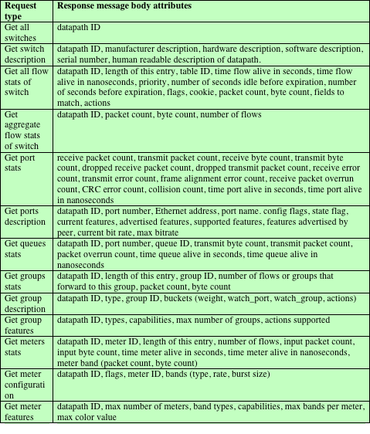
Table 5.2
Ryu REST APIs for Retrieving Switch and Updating Switch Statistics and Parameters
(a) Retrieve Switch Statistics using GET
Notes:
Table 5.2 lists all the API functions for retrieving switch statistics and parameters
that use the GET message type. There are also several functions that use the POST
message type, in which the request message body includes a list of parameters that
must be matched.

Slide 29
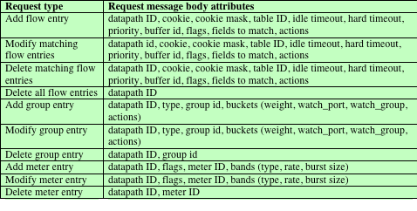
Table 5.2
Ryu REST APIs for Retrieving Switch and Updating Switch Statistics and Parameters
(b) Update Switch Statistics Filtered by Fields using POST

Slide 30
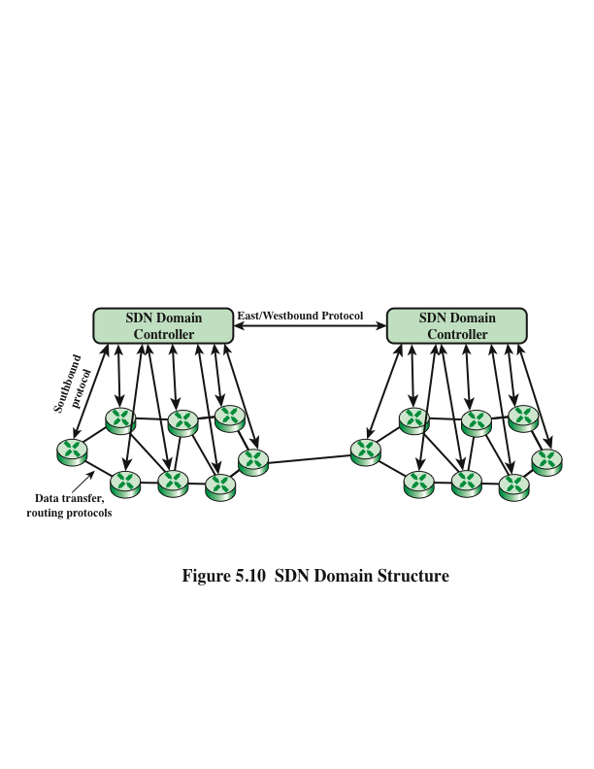
Notes:
A key architectural design decision is whether a single centralized controller or
a distributed set of controllers will be used to control the data plane switches. A
centralized controller is a single server that manages all the data plane switches in the
network.
In a large enterprise network, the deployment of a single controller to manage all
network devices would prove unwieldy or undesirable. A more likely scenario is that
the operator of a large enterprise or carrier network divides the whole network into
a number of nonoverlapping SDN domains, also called SDN islands (Figure 5.10),
managed by distributed controllers. Reasons for using SDN domains include those in
the list that follows.
■ Scalability: The number of devices an SDN controller can feasibly manage
is limited. Therefore, a reasonably large network may need to deploy multiple
SDN controllers.
■ Reliability: The use of multiple controllers avoids the risk of a single point of
failure.
■ Privacy: A carrier may choose to implement different privacy policies in
different SDN domains. For example, an SDN domain may be dedicated to a
set of customers who implement their own highly customized privacy policies,
requiring that some networking information in this domain (for example,
network topology) should not be disclosed to an external entity.
■ Incremental deployment: A carrier’s network may consist of portions of
legacy and nonlegacy infrastructure. Dividing the network into multiple individually
manageable SDN domains allows for flexible incremental deployment.
Distributed controllers may be collocated in a small area, or widely dispersed, or a
combination of the two. Closely placed controllers offer high throughput and are
appropriate for data centers, whereas dispersed controllers accommodate multilocation
networks.
Typically, controllers are distributed horizontally. That is, each controller governs
a nonoverlapping subset of the data plane switches. A vertical architecture is also
possible, in which control tasks are distributed to different controllers depending on
criteria such as network view and locality requirements.
In a distributed architecture, a protocol is needed for communication among the
controllers. In principle, a proprietary protocol could be used for this purpose,
although an open or standard protocol would clearly be preferable for purposes of
interoperability.
The functions associated with the east/westbound interface for a distributed architecture
include maintaining either a partitioned or replicated database of network
topology and parameters, and monitoring/notification functions. The latter function
includes checking whether a controller is alive and coordinating changes in assignment
of switches to controllers.

Slide 31
High-Availability Clusters
The primary node is responsible for answering all traffic that is sent to the cluster’s external IP address and holds a read/write copy of the configuration data
The second node operates as a standby, with a read-only copy of the configuration data, which is kept current with the primary’s copy
The secondary node monitors the state of the external IP
If the secondary node determines that the primary node is no longer answering the external IP, it triggers a failover, changing its mode to that of primary node
It assumes the responsibility for answering the external IP and changes its copy of configuration data to be read/write
If the old primary reestablishes connectivity, there is an automatic recovery process trigger to convert the old primary to secondary status so that configuration changes that are made during the failover period are not lost
Notes:
Within a single domain, the controller function can be implemented on a highavailability
(HA) cluster . Typically, there would be two or more nodes that share
a single IP address that is used by external systems (both north and southbound)
to access the cluster. An example is the IBM SDN for Virtual Environments
product, which uses two nodes. Each node is considered a peer of the other node in
the cluster for data replication and sharing of the external IP address. When HA is
running, the primary node is responsible for answering all traffic that is sent to the
cluster’s external IP address and holds a read/write copy of the configuration data.
Meanwhile, the second node operates as a standby, with a read-only copy of the
configuration data, which is kept current with the primary’s copy. The secondary
node monitors the state of the external IP. If the secondary node determines that the
primary node is no longer answering the external IP, it triggers a failover, changing
its mode to that of primary node. It assumes the responsibility for answering the
external IP and changes its copy of configuration data to be read/write. If the old
primary reestablishes connectivity, there is an automatic recovery process trigger
to convert the old primary to secondary status so that configuration changes that are
made during the failover period are not lost.
ODL Helium has HA built in, and Cisco XNC and the Open Network controller have
HA features (up to five in a cluster).

Slide 32
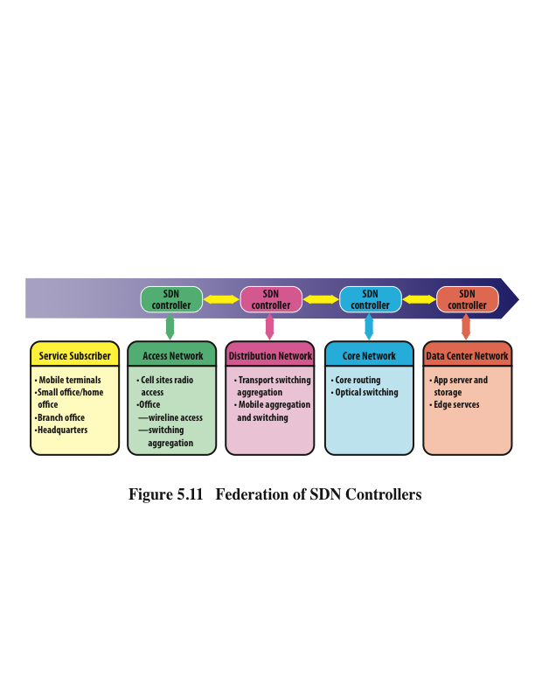
Notes:
The distributed SDN architecture discussed in the preceding paragraphs refers to a
system of SDN domains that are all part of a single enterprise network. The domains
may be collocated or on separate sites. In either case, the management of all the data
plane switches is under the control of a single network management function.
It is also possible for SDN networks that are owned and managed by different organizations
to cooperate using east/westbound protocols. Figure 5.11 is an example of the
potential for inter-SDN controller cooperation.
In this configuration, we have a number of service subscribers to a data center network
providing cloud-based services. Typically, as was illustrated previously in Figure 1.3,
subscribers are connected to the service network through a hierarchy of access, distribution,
and core networks. These intermediate networks may all be operated by the
data center network, or they may involve other organizations. In the latter case, if
all the networks implement SDN, they need to share common conventions for share
control plane parameters, such as quality of service (QoS), policy information, and
routing information.

Slide 33
Border Gateway Protocol (BGP)
Was developed for use in conjunction with internets that use the TCP/IP suite
Has become the preferred exterior router protocol (ERP) for the Internet
Enables routers, called gateways in the standard, in different autonomous systems to cooperate in the exchange or routing information
The protocol operates in terms of messages, which are sent over TCP connections
The current version of BGP is BGP-4
Notes:
Before proceeding further with our discussion, it will be useful to provide an overview
of the Border Gateway Protocol (BGP). BGP was developed for use in conjunction
with internets that use the TCP/IP suite, although the concepts are applicable to any
internet. BGP has become the preferred exterior router protocol (ERP) for the
Internet.
BGP enables routers, called gateways in the standard, in different autonomous systems
to cooperate in the exchange of routing information. The protocol operates in terms
of messages, which are sent over TCP connections. The current version of BGP is
known as BGP-4.

Slide 34
BGP
Three functional procedures are involved in BGP:
Neighbor acquisition
The term neighbor refers to two routers that share the same network
Occurs when two neighboring routers in different autonomous systems agree to exchange routing information regularly
Neighbor reachability
Once a neighbor relationship is established this procedure is used to maintain the relationship
Each partner needs to be assured that the other partner still exists and is still engaged in the neighbor relationship
Network reachability
Each router maintains a database of the networks that it can reach and the preferred route for reaching each network
Whenever a change is made to this database, the router issues an Update message that is broadcast to all other routers for which it has a neighbor relationship
Notes:
Three functional procedures are involved in BGP:
■ Neighbor acquisition
■ Neighbor reachability
■ Network reachability
Two routers are considered to be neighbors if they are attached to the same network
or communication link. If they are attached to the same network, communication
between the neighbor routers might require a path through other routers within the
shared network. If the two routers are in different autonomous systems, they may
want to exchange routing information. For this purpose, it is necessary first to perform
neighbor acquisition . The term neighbor refers to two routers that share the same
network. In essence, neighbor acquisition occurs when two neighboring routers in
different autonomous systems agree to exchange routing information regularly. A
formal acquisition procedure is needed because one of the routers may not want to
participate. For example, the router may be overburdened and may not want to be
responsible for traffic coming in from outside the AS. In the neighbor acquisition
process, one router sends a request message to the other, which may either accept
or refuse the offer. The protocol does not address the issue of how one router knows
the address or even the existence of another router, nor how it decides that it needs to
exchange routing information with that particular router. These issues must be dealt
with at configuration time or by active intervention of a network manager.
To perform neighbor acquisition, one router sends an Open message to another. If the
target router accepts the request, it returns a Keepalive message in response.
Once a neighbor relationship is established, the neighbor reachability procedure
is used to maintain the relationship. Each partner needs to be assured that the other
partner still exists and is still engaged in the neighbor relationship. For this purpose,
the two routers periodically issue Keepalive messages to each other.

Slide 35
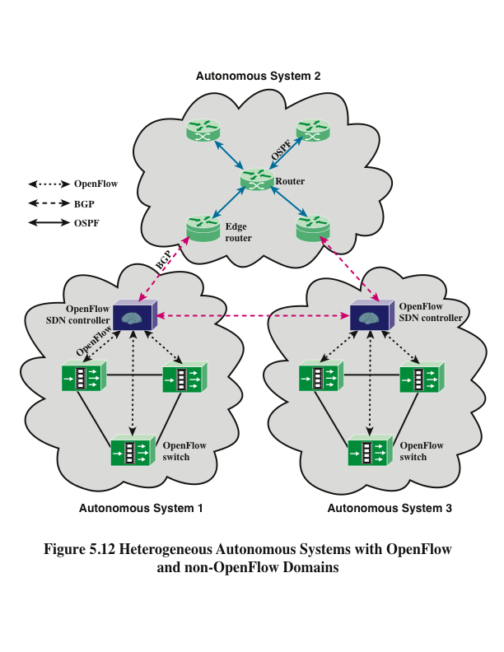
Notes:
For routing outside a controller’s domain, the controller establishes a BGP connection
with each neighboring router. Figure 5.12 illustrates a configuration with two SDN
domains that are linked only through a non-SDN AS.
Within the non-SDN AS, OSPF is used for interior routing. OSPF is not needed in
an SDN domain; rather, the necessary routing information is reported from each
data plane switch to the centralized controller using a southbound protocol (in this
case, OpenFlow). Between each SDN domain and the AS, BGP is used to exchange
information, such as the following:
■ Reachability update: Exchange of reachability information facilitates inter-
SDN domain routing. This allows a single flow to traverse multiple SDNs and
each controller can select the most appropriate path in the network.
■ Flow setup, tear-down, and update requests: Controllers coordinate
flow setup requests, which contain information such as path requirements,
QoS, and so on, across multiple SDN domains.
■ Capability Update: Controllers exchange information on network-related
capabilities such as bandwidth, QoS and so on, in addition to system and software
capabilities available inside the domain.
Several additional points are worth observing with respect to Figure 5.12:
■ The figure depicts each AS as a cloud containing interconnected routers and, in
the case of an SDN domain, a controller. The cloud represents an internet, so
that the connection between any two routers is a network within the internet.
Similarly, the connection between two adjacent autonomous systems is a network,
which may be part of one of the two adjacent autonomous systems, or a
separate network.
■ For an SDN domain, the BGP function is implemented in the SDN controller
rather than a data plane router. This is because the controller is responsible for
managing the topology and making routing decisions.
■ The figure shows a BGP connection between autonomous systems 1 and 3.
It may be that these networks are not directly connected by a single network.
However, if the two SDN domains are part of a single SDN system, or if they are
federated, it may be desirable to exchange additional SDN-related information.

Slide 36
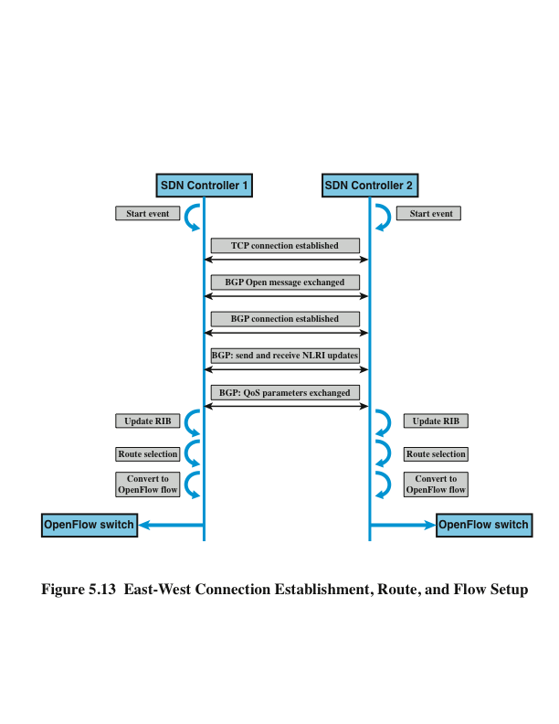
Notes:
A common practice for inter-AS interconnection is a best-effort interconnection
only. That is, traffic forwarding between autonomous systems is without traffic class
differentiation and without any forwarding guarantee. It is common for network
providers to reset any IP packet traffic class markings to zero, the best-effort marking,
at the AS ingress router, which eliminates any traffic differentiation. Some providers
perform higher-layer classification at the ingress to guess the forwarding requirements
and to match on their AS internal QoS forwarding policy. There is no standardized
set of classes, no standardized marking (class encoding), and no standardized
forwarding behavior, that cross-domain traffic could rely on. However RFC 4594
(Configuration Guidelines for DiffServ Service Classes , August 2006) provides
a set of “best practices” related to this parameters. QoS policy decisions are taken
by network providers independently and in an uncoordinated fashion. This general
statement does not cover existing individual agreements, which do offer quality-based
interconnection with strict QoS guarantees. However, such service level agreement
(SLA)-based agreements are of bilateral or multilateral nature and do not offer a
means for a general “better than best effort” interconnection.
IETF is currently at work on a standardized scheme for QoS marking using BGP
(BGP Extended Community for QoS Marking , draft-knoll-idr-qos-attribute-12, July
10, 2015). Meanwhile, SDN providers have implemented their own capabilities using
the extensible nature of BGP. In either case, the interaction between SDN controllers
in different domains using BGP would involve the steps illustrated in Figure 5.13 and
described in the list that follows.
1. The SDN controller must be configured with BGP capability and with information
about the location of neighboring BGP entices.
2. BGP is triggered by a start or activation event within the controller.
3. The BGP entity in the controller attempts to establish a TCP connection with
each neighboring BGP entity.
4. Once a TCP connection is established, the controller’s BGP entity exchanges
Open messages with the neighbor. Capability information is exchanged with
using the Open messages.
5. The exchange completes with the establishment of a BGP connection.
6. Update messages are used to exchange NLRI (network layer reachability information),
indicating what networks are reachable via this entity. Reachability
information is used in the selection of the most appropriate data path between
SDN controllers. Information obtained through NLRI parameter is used to
update the controller’s Routing Information Base (RIB). This in turn enables the
controller to set the appropriate flow information in the data plane switches.
7. The Update message can also be used to exchange QoS information, such as
available capacity.
8. Route selection is done when more than one path is available based on BGP
process decision. Once the path is established packets can traverse successfully
between two SDN domains.

Slide 37
IETF SDNi
A draft specification that defines common requirements to coordinate flow setup and exchange reachability information across multiple domains
SDNi functionality, as defined in the document, includes:
Coordinate flow setup originated by application, containing information such as path requirement, QoS, and service level agreements across multiple SDN domains
Exchange reachability information to facilitate inter-SDN routing; this will allow a single flow to traverse multiple SDNs and have each controller select the most appropriate path when multiple such paths are available
Notes:
IETF has developed a draft specification that defines common requirements to
coordinate flow setup and exchange reachability information across multiple domains,
referred to as SDNi (SDNi: A Message Exchange Protocol for Software Defined
Networks across Multiple Domains , draft-yin-sdn-sdni-00.txt, June 27, 2012). The
SDNi specification does not define an east/westbound SDN protocol but rather
provides some of the basic principles to be used in developing such a protocol.
SDNi functionality, as defined in the document, includes the following:
■ Coordinate flow setup originated by applications, containing information such
as path requirement, QoS, and service level agreements across multiple SDN
domains.
■ Exchange reachability information to facilitate inter-SDN routing. This will
allow a single flow to traverse multiple SDNs and have each controller select
the most appropriate path when multiple such paths are available.
SDNi depends on the types of available resources and capabilities available and
managed by the different controllers in each domain. Therefore, it is important to
implement SDNi in a descriptive and open manner so that new capabilities offered by
different types of controllers will be supported. Because SDN in essence allows for
innovation, it is important that data exchanged between controllers will be dynamic
in nature; that is, there should be some metadata exchange that will allow SDNi to
exchange information about unknown capabilities.
The message types for SDNi tentatively include the following:
■ Reachability update
■ Flow setup/teardown/update request (including application capability
requirement such as QoS, data rate, latency, and so on)
■ Capability update (including network-related capabilities, such as data rate and
QoS, and system and software capabilities available inside the domain)

Slide 38
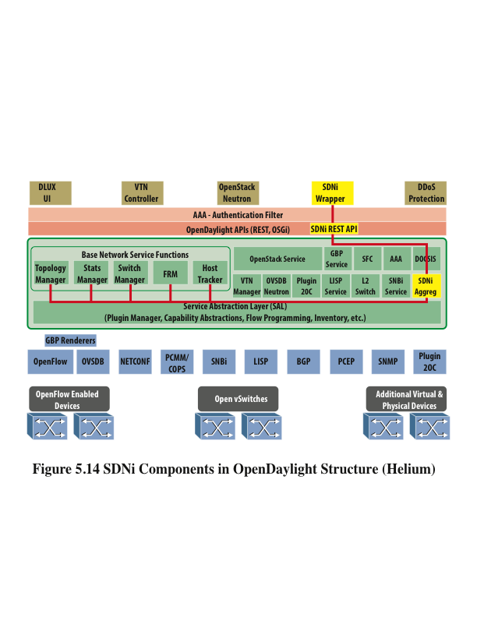
Notes:
Included in the OpenDaylight architecture is an SDNi capability for connecting
multiple OpenDaylight federated controllers in a network and sharing topology
information among them. This capability appears to be compatible with the IETF
specification for an SDNi function. The SDNi application deployable on an
OpenDaylight controller consists of three components, as illustrated in Figure 5.14
and described in the list that follows.
Included in the OpenDaylight architecture is an SDNi capability for connecting
multiple OpenDaylight federated controllers in a network and sharing topology
information among them. This capability appears to be compatible with the IETF
specification for an SDNi function. The SDNi application deployable on an
OpenDaylight controller consists of three components, as illustrated in Figure 5.14
and described in the list that follows.
■ SDNi REST API: SDNi REST APIs fetch the aggregated information from
the northbound plug-in (SDNi aggregator).
■ SDNi wrapper: SDNi BGP wrapper is responsible for the sharing and collecting
information to/from federated controllers.

Slide 39
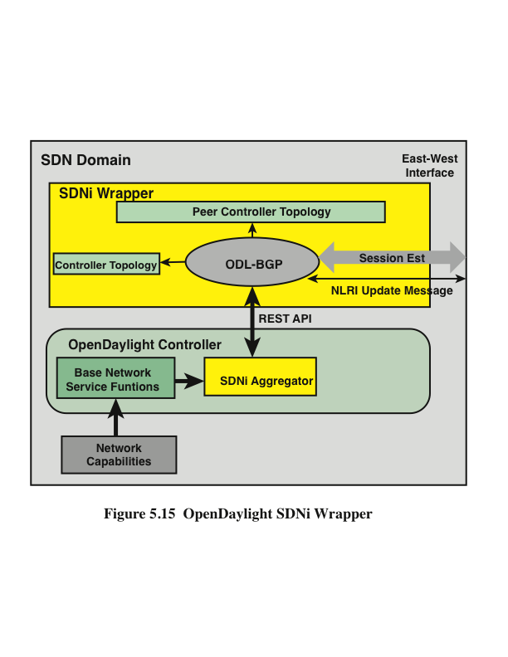
Notes:
Figure 5.15 shows the interrelationship of the components, with a more detailed look
at the SDNi wrapper. The SDNi aggregator collects statistics and parameters from the
base network service functions, on behalf of requests via the REST API. The heart
of the wrapper is an OpenDaylight implementation of the Border Gateway Protocol
(BGP). BGP is an ERP suitable for exchanging routing information between routers
that connect SDN domains.

Slide 40
End of Chapter 5

